Slide 1
Osama Sahib Jafar

Slide 2
Subjects:
Numerical Integration:
1- Trapezoidal Method.
2- Simpsons Method.
Solving Ordinary Differential Equations:
1- Euler’s Method.
2- Runge-Kutta Method. (2nd order).

Slide 6
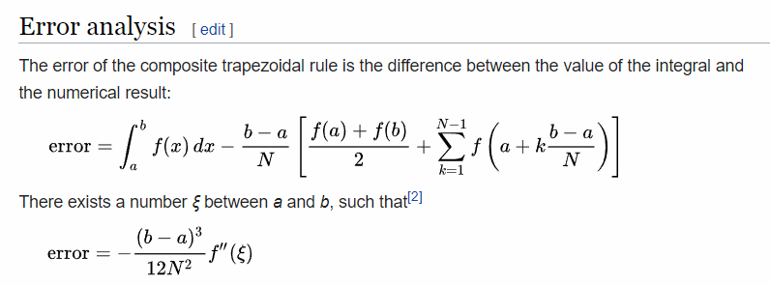

Slide 8
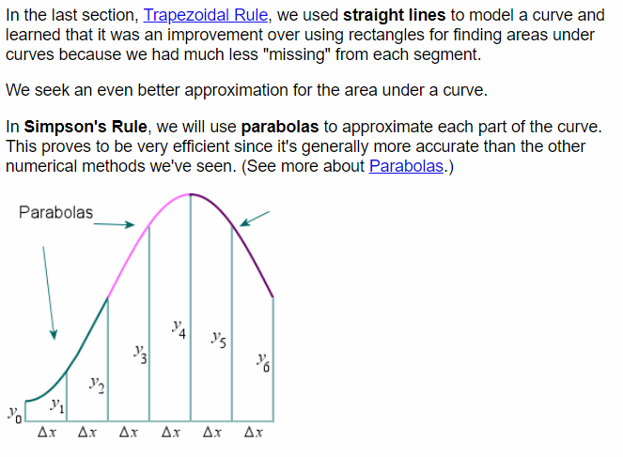

Slide 9
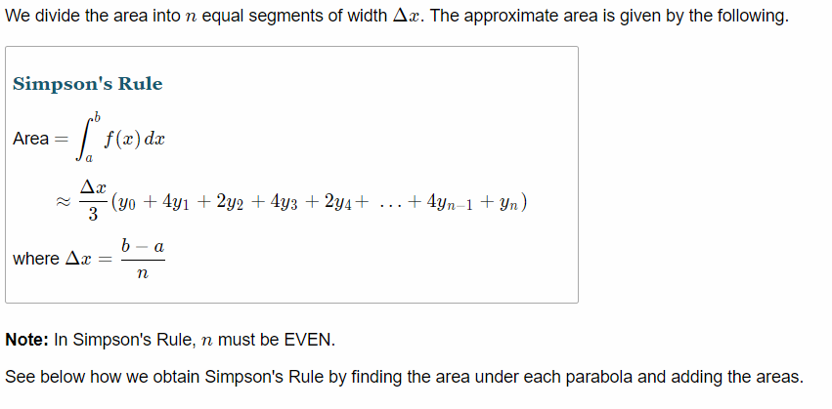

Slide 10
